Slide 1
Data Analysis Report
Abu Bakr Soliman

Slide 2
Cities
We mentioned before in [Data Cleaning] chapter, the challenge to reduce the unstructured format of cities names values.
We success in this early experiment to reduce the variance errors by more than 100%. To stop at more accurate analytics about the geographical nature of posted jobs through the provided dataset.

Slide 3
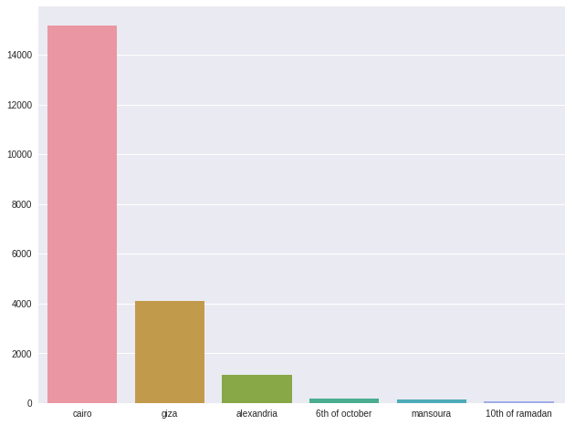
Cities
List of the top 6 cities by number of published jobs.

Slide 4
Views
One of most required data needed by both business and marketing managers.
It could express a factor of users responsive to the published jobs and the website.

Slide 5
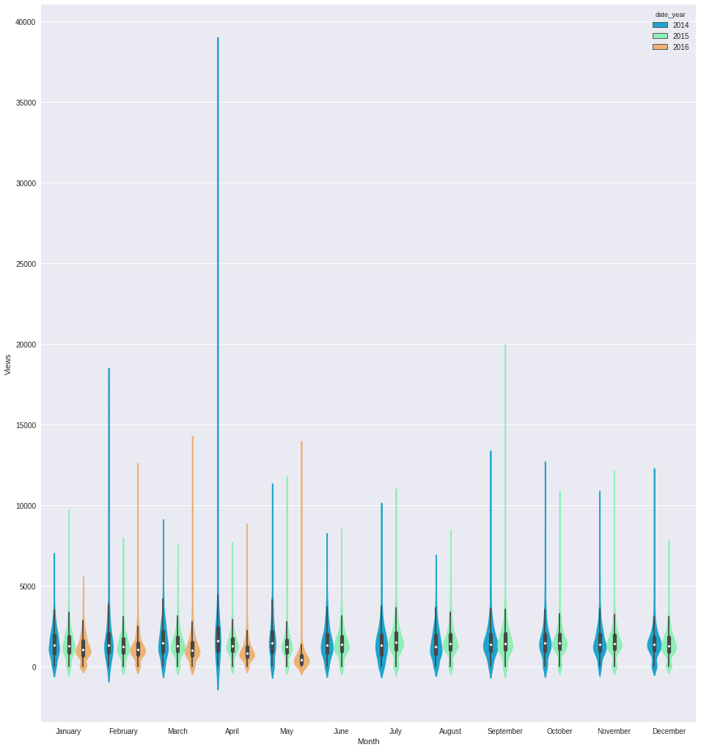
Views
This chart express jobs views distribution over all years months.
We could interpret the years distribution according to the colors in the top right corner.
This violin chart express the distribution density. So more thick parts shows more views.
We could notice that although there are some jobs could reach 40,000 views, but most of jobs views are less than 5,000.

Slide 6
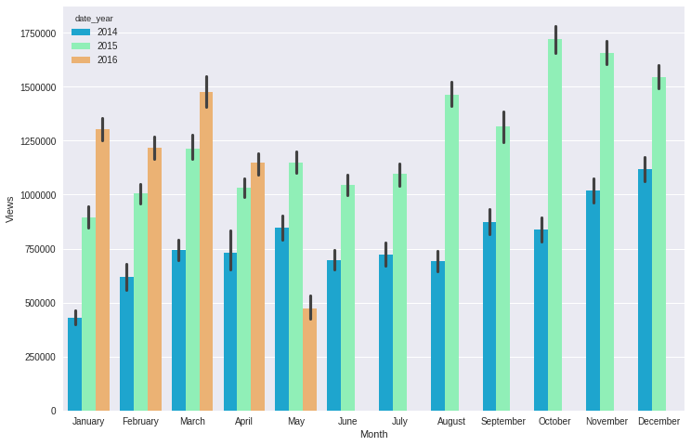
Views
This bar chart shows the total views of each months through each different year.
We could notice the highest views in the last quarter of every year [although we do not have enough data about 2016]

Slide 7
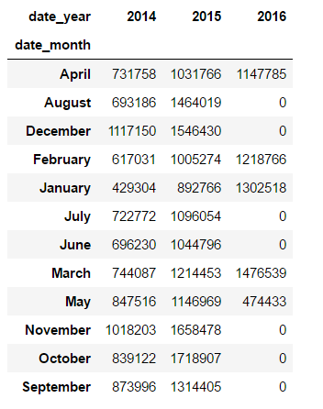
Views
We could let the real numbers talk here.

Slide 8
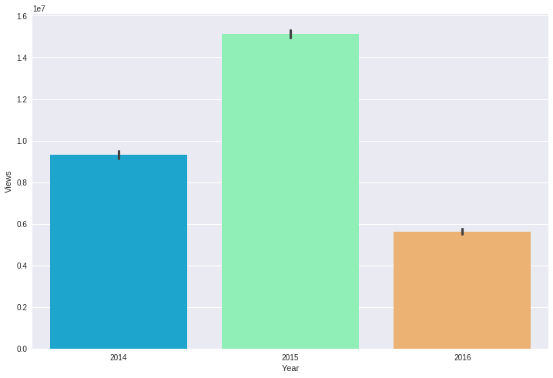
Views
This chart shows the total number of jobs views for each year.
We must mention here the missed data about 2016.

Slide 9
Published Jobs

Slide 10
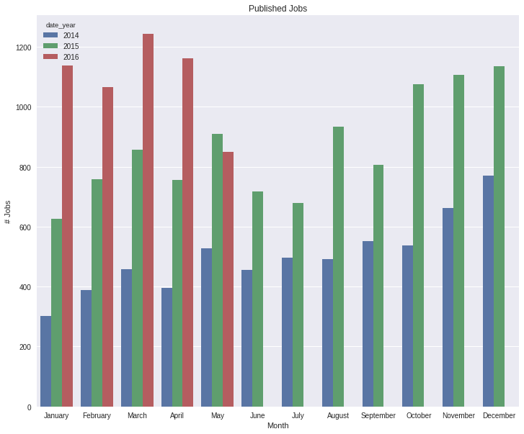
Published Jobs
This chart shows the total number of published jobs in each year/month.
We could notice the increased responsive of job providers to use Wuzzuf from 2014 to 2015.

Slide 11
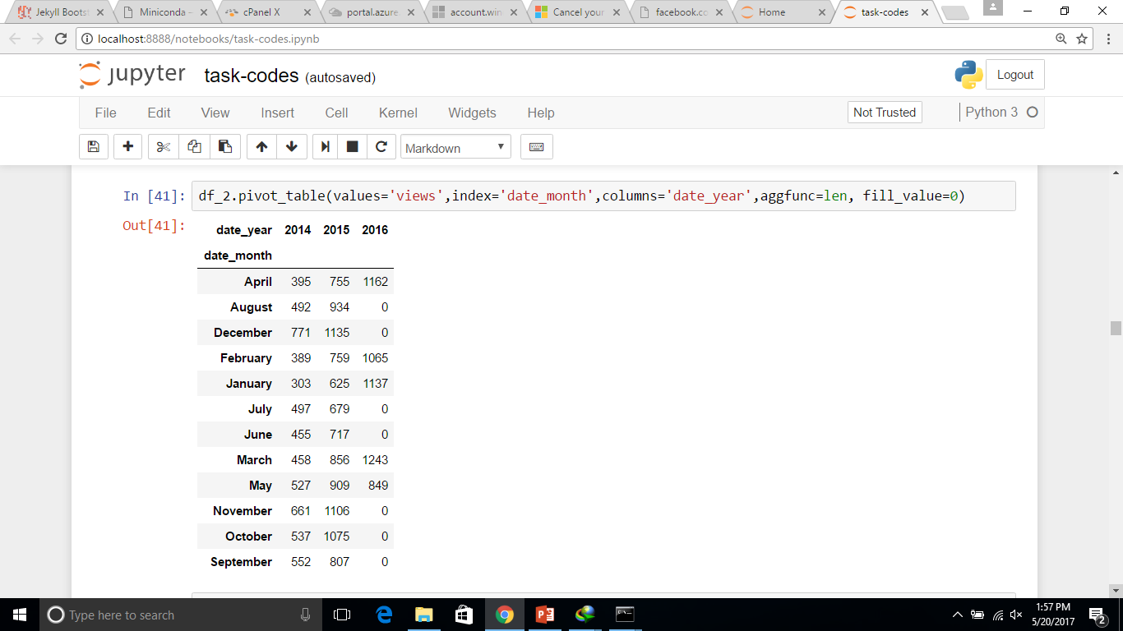
Published Jobs
We could express this more by numbers

Slide 12
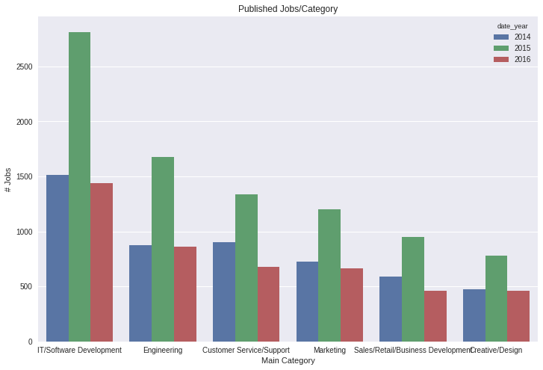
Published Jobs
This chart express the top 6 main categories by total published jobs, and their distribution over the past years.

Slide 13
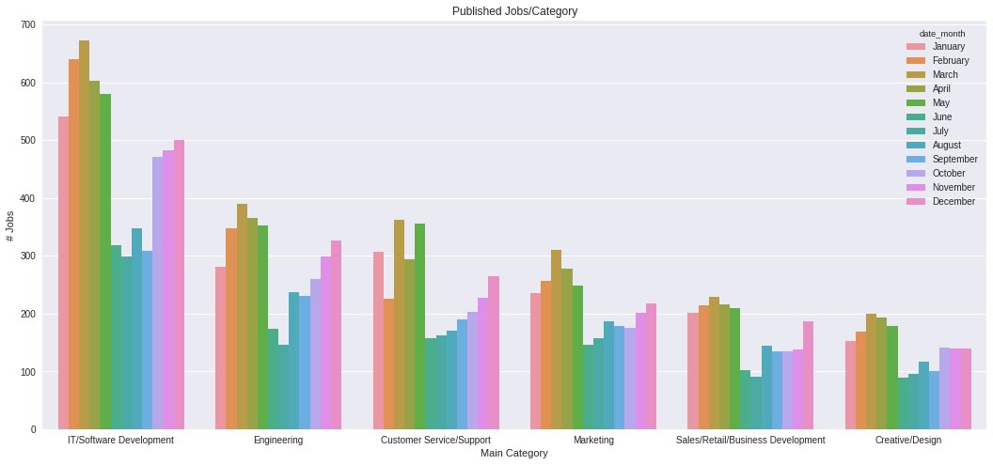
Published Jobs
This chart shows the top 6 main categories by total published jobs and the distributions over each month.

Slide 14
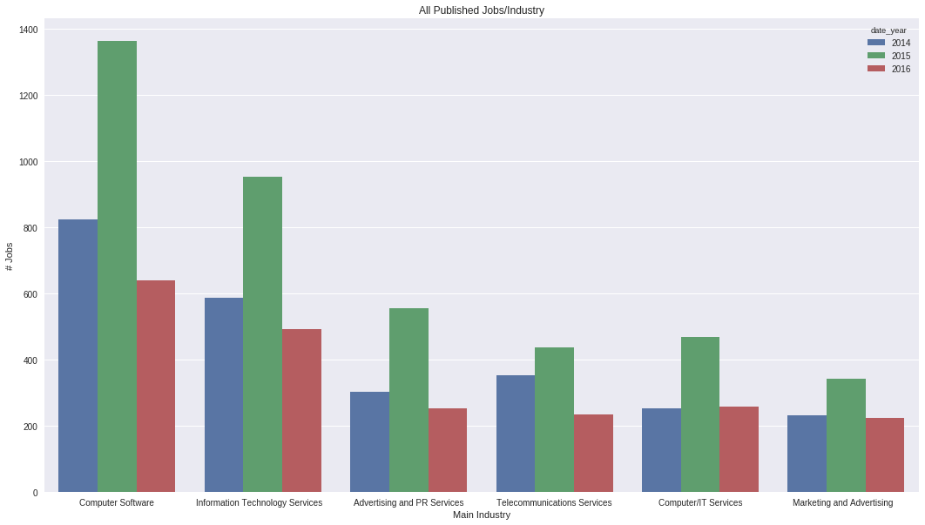
Published Jobs
This chart shows the top 6 main industries fields by total published jobs.

Slide 15
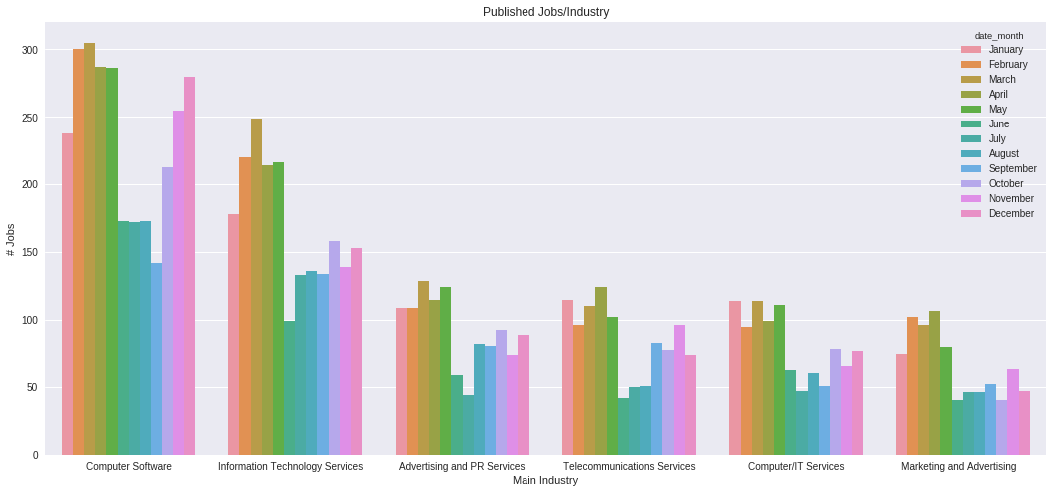
Published Jobs
This chart shows the top 6 main industries fields by total published jobs and the distributions over each month.

Slide 16
Salaries

Slide 17
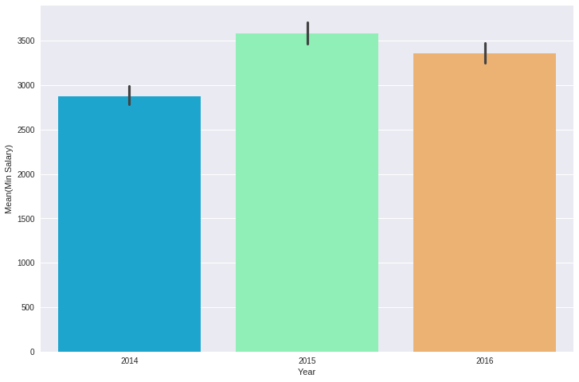
Salaries
This chart shows the distribution of minimum salaries over years.
Since we had missed data for 2016. We could notice the increasing of minimum salaries from 2014 to 2015 by about 20%.

Slide 18
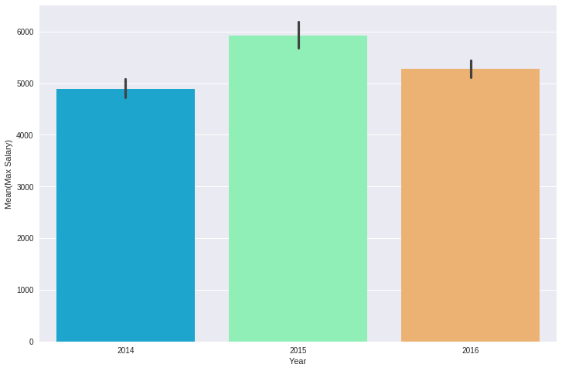
Salaries
This chart shows the distribution of maximum salaries over years.
Since we had missed data for 2016. We could notice the increasing of maximum salaries from 2014 to 2015 by about 20%.

Slide 19
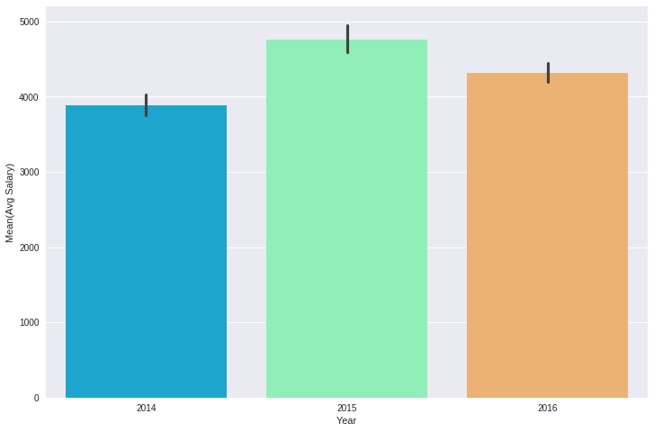
Salaries
This chart shows the distribution of AVERAGE salaries over years.
Since we had missed data for 2016. We could notice the increasing of average salaries from 2014 to 2015 by about 20%.

Slide 20
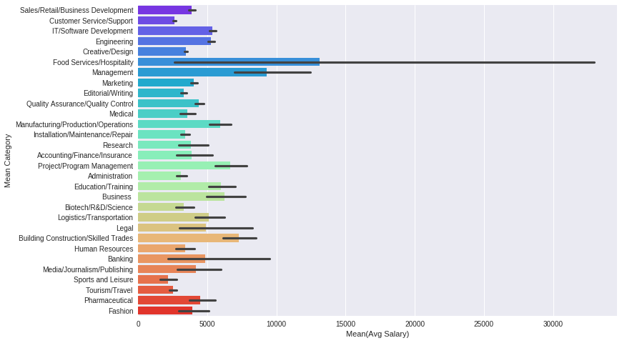
Salaries
This chart shows the average salaries over the job categories.
We could notice the highest salaries averages in [Food Service / Hospitability] category. Although it is not one of the top most targeted categories.

Slide 21
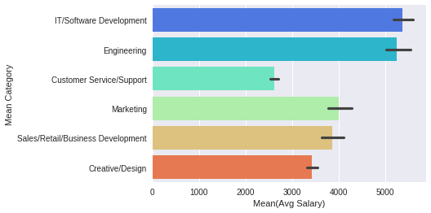
Salaries
This chart shows the average salaries over the top 6 targeted categories.

Slide 22
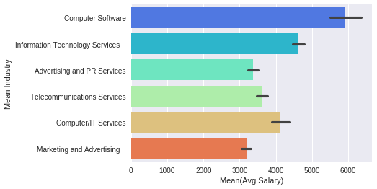
Salaries
This chart shows the average salaries over the top 6 targeted industries.

Slide 23
Vacancies

Slide 24
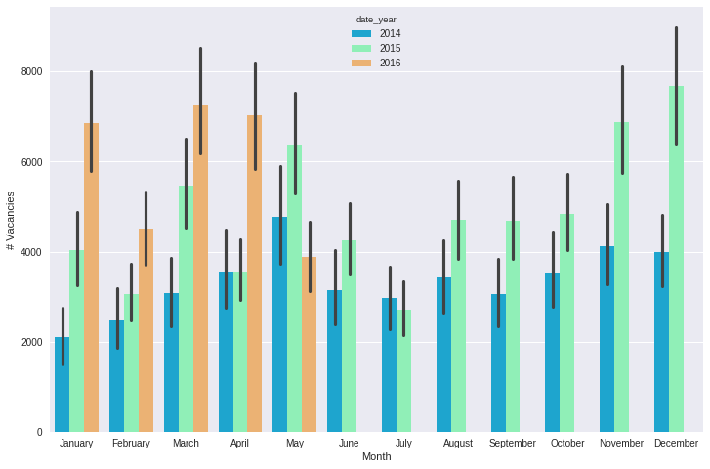
Vacancies
This chart shows total number of available vacancies over each month.

Slide 25
Career Levels

Slide 26
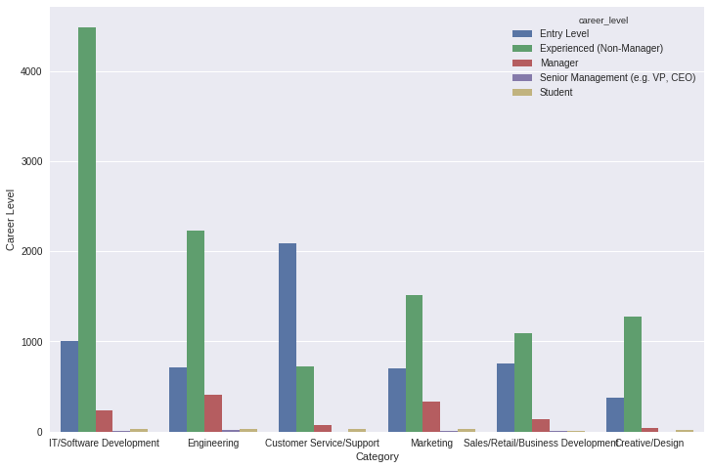
Career Levels
This chart shows career levels jobs distribution for each of the top 6 targeted categories.

Slide 27
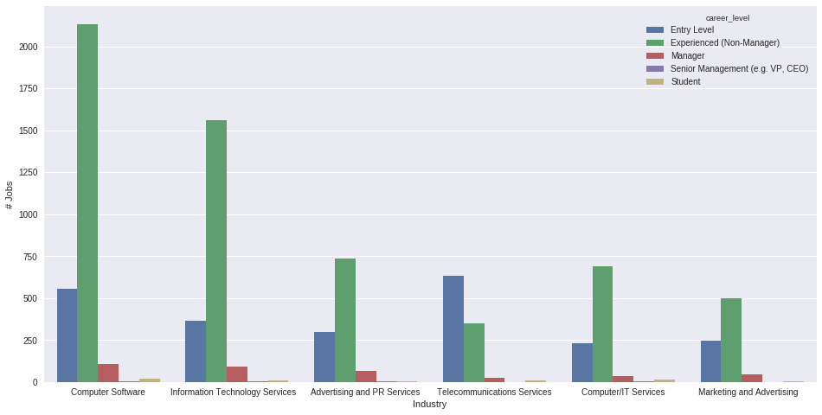
Career Levels
This chart shows career levels jobs distribution for each of the top 6 targeted industries.

Slide 28
Job Titles

Slide 29
Job Titles
We made some data cleaning and pre-processing techniques to decrease noise variance in this field.
Extracting info from this field could contribute in many domains like marketing and SEO.

Slide 30
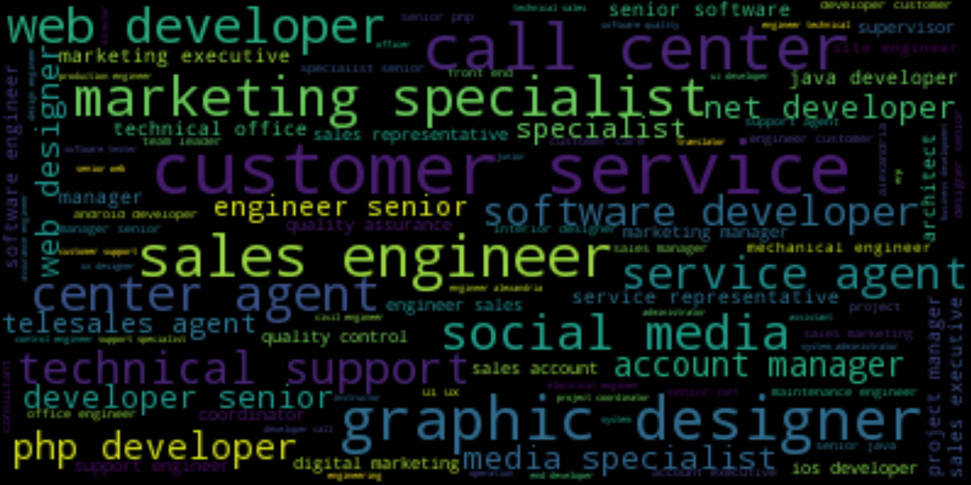
Job Titles
This word-cloud graph could present more specific job titles which are not in the prepared select [categories/industries] menus. And the size of the job title express how important it is.

Slide 31
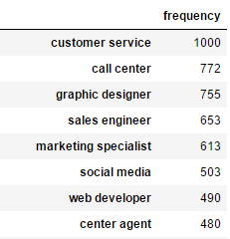
Job Titles
We could look deeper to know how many time this job title is requested in a job post.
A more detailed table could found in the attached code file.

Slide 32
Data-Mining / Machine Learning

Slide 33
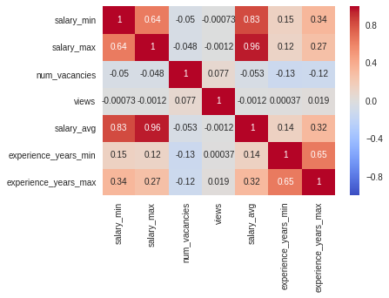
DM/ML
This heat-map could express the correlations between the different values.
For example, we could notice that the more vacancies is in the job will refer to lower average salaries [-0.053]

Slide 34
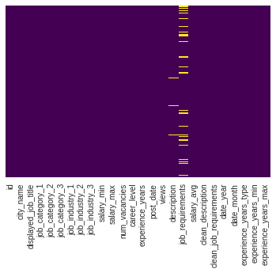
DM/ML
Before Mining the dataset, we also need to stop at the distribution of N/A values in each column.

Slide 35
DM/ML
We built a Linear Regression model, which is mentioned in details in the [codes] appendix.
The regression predictions are some tricky since the limited scope here and the missed previous experience of built models before.
We will not going here with the detailed steps of enhancing the model accuracy, but we will go in a specific feature which could help us a lot to understand the data.

Slide 36
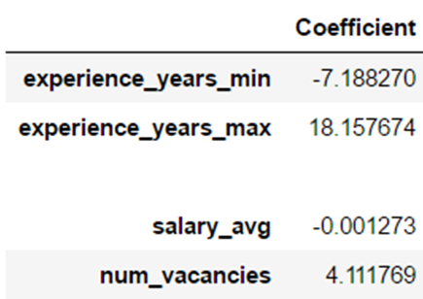
DM/ML
We built a regression model to predict views number of each job post.
The Coefficient table could express a lot about the factors could increase the number of views.
For example, each increased units in [num_vacancies] could increase 4.11 units in views.
All of these numbers is based on the model accuracy, which is could reached after a lot of work with business supervisors contributions.

Slide 37
Software Structure Recommendations

Slide 38
Recommendation
Next, I am going to recommend some system modification to reach more accurate and clean analysis.
Job Posting
We could replace the [city name] text field by a select menu of all cities. It will reach us to more accurate geographical analysis.
Modify the [max and min experience years] to be select menus. And make the minimum field a required field.
Although we could not provide all job titles in a select menu. But we could provide an auto-complete feature to recommend some job titles for job providers.
Could we record the viewed jobs series by each user or even a visitor ?!. It could enhance the recommendation system.

Slide 39
Recommendation
Next, I am going to recommend some system modification to reach more accurate and clean analysis.
User Profile
We could ask the user to enter the certifications categories. So we could connect especially juniors to the jobs providers. And enhance the recommendation systems.
What about appending a new field for references. And limit each reference to be a Wuzzuf or linked in user. References could express more the nature of the user works, and help the jobs providers to know more about the seeker.
We could try to build a simple anthology system for companies and organizations. I know it could take a lot of time. But with some simple processes, we could generate the first seed. This feature could enhance the relations between users and jobs communities.

